Slide 1
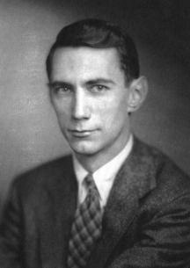
Claude Elwood Shannon (1916-2001)
D’après Scientific American 225 180 (1971)
“My greatest concern was what to call it. I thought of calling it information, but the word was overly used, so I decided to call it uncertainty. When I discussed it with John von Neumann, he had a better idea. Von Neumann told me,
“You should call it entropy, for two reasons. In the first place your uncertainty function has been used in statistical mechanics under that name, so it already has a name. In the second place, and more important, no one really knows what entropy really is, so in a debate you will always have the advantage.””

