Slide 1
Physique Statistique (L3)
ENS-Lyon UCBL (Lyon 1)
Frédéric Caupin
L’ensemble
microcanonique

Slide 2
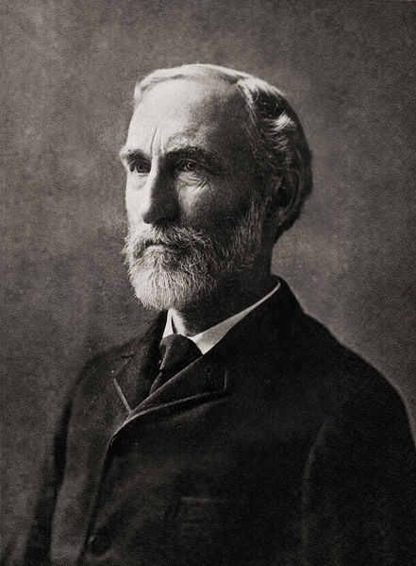
Les ensembles de Gibbs
“We may imagine a great number of systems of the same nature, but differing in the configurations and velocities which they have at a given instant, and differing not merely infinitesimally, but it may be so as to embrace every conceivable combination of configuration and velocities. And here we may set the problem, not to follow a particular system through its succession of configurations, but to determine how the whole number of systems will be distributed among the various conceivable configurations and velocities at any required time, when the distribution has been given for some one time
What we know about a body can generally be described most accurately and most simply by saying that it is one taken at random from a great number (ensemble) of bodies which are completely described”
Josiah Willard Gibbs 1839-1903
Elementary principles in statistical mechanics,1902

Slide 3
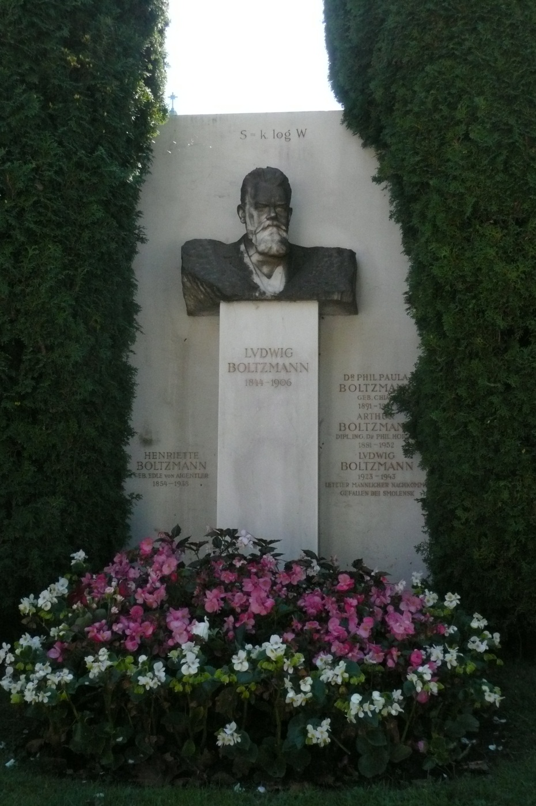
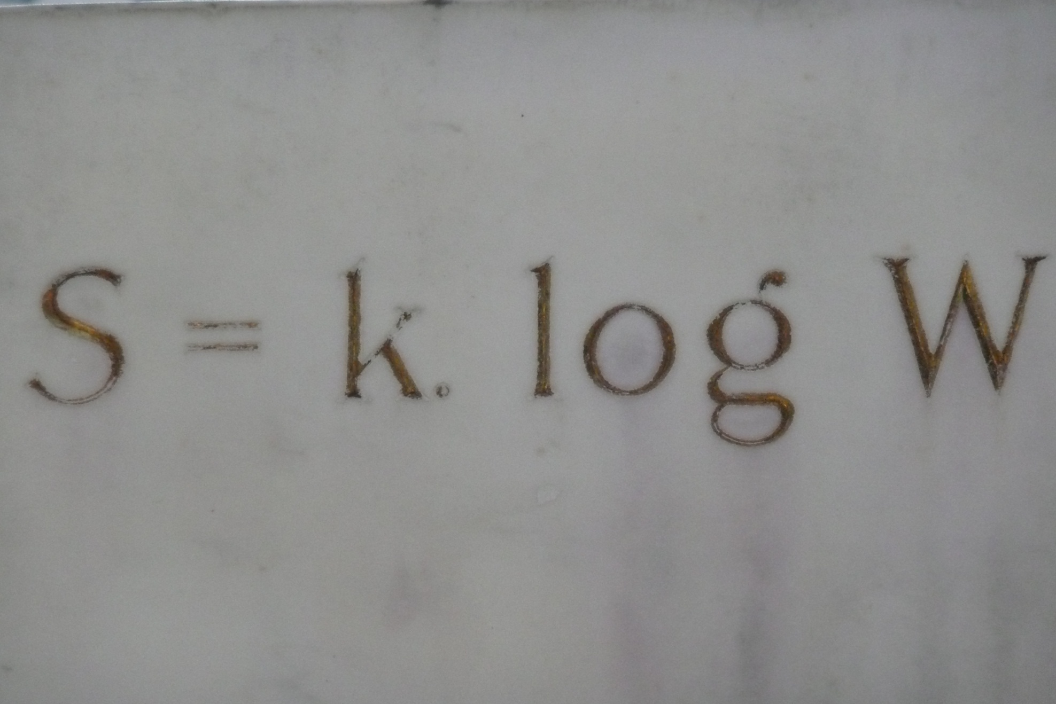
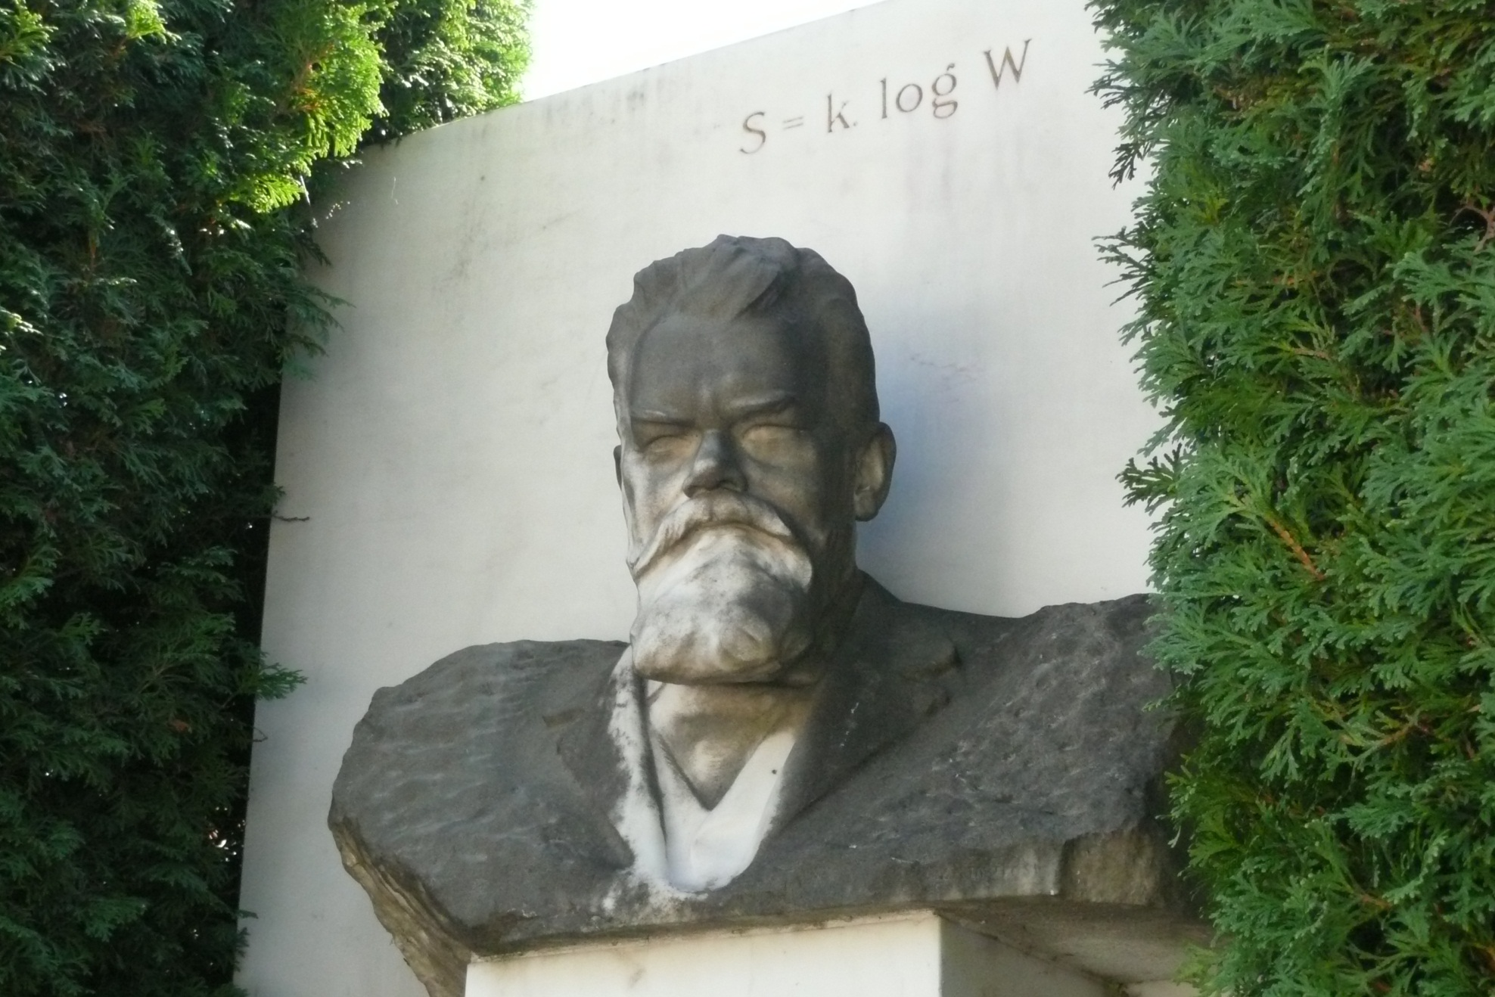
Ludwig Boltzmann 1844-1906

Slide 4
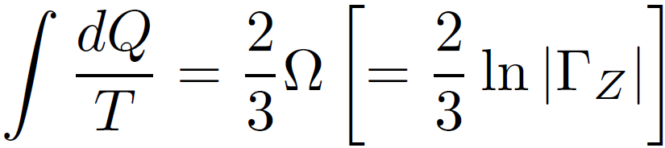
Ludwig Boltzmann 1844-1906
S = k_{B} ln Ω
même si (d’après Uffink 2006)
Boltzmann n’a pas écrit cette formule, mais :
S
k_{B}
dans les unités
de Boltzmann
Ω

Slide 5
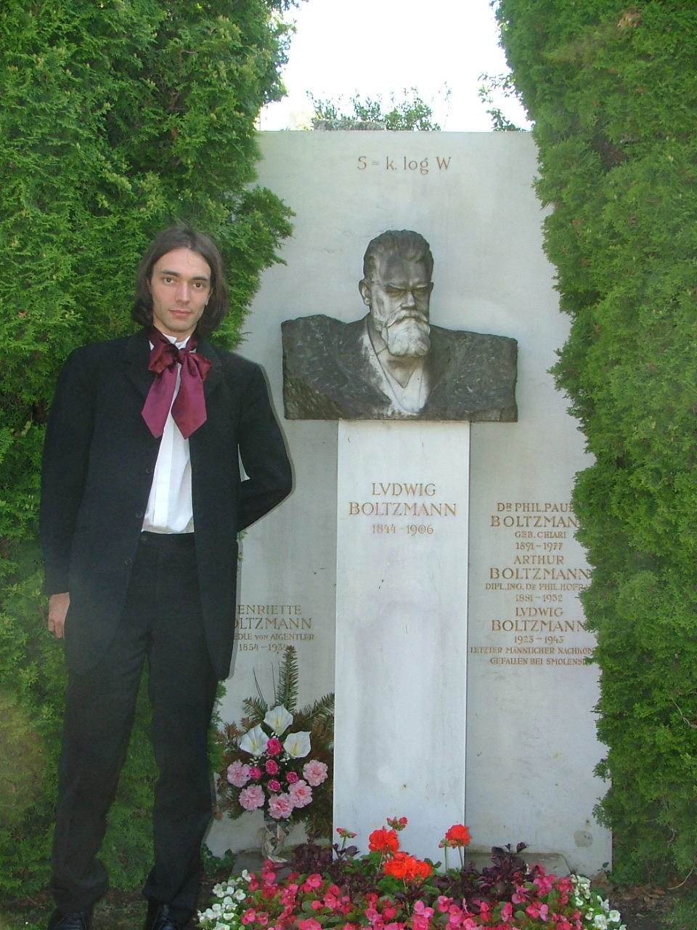
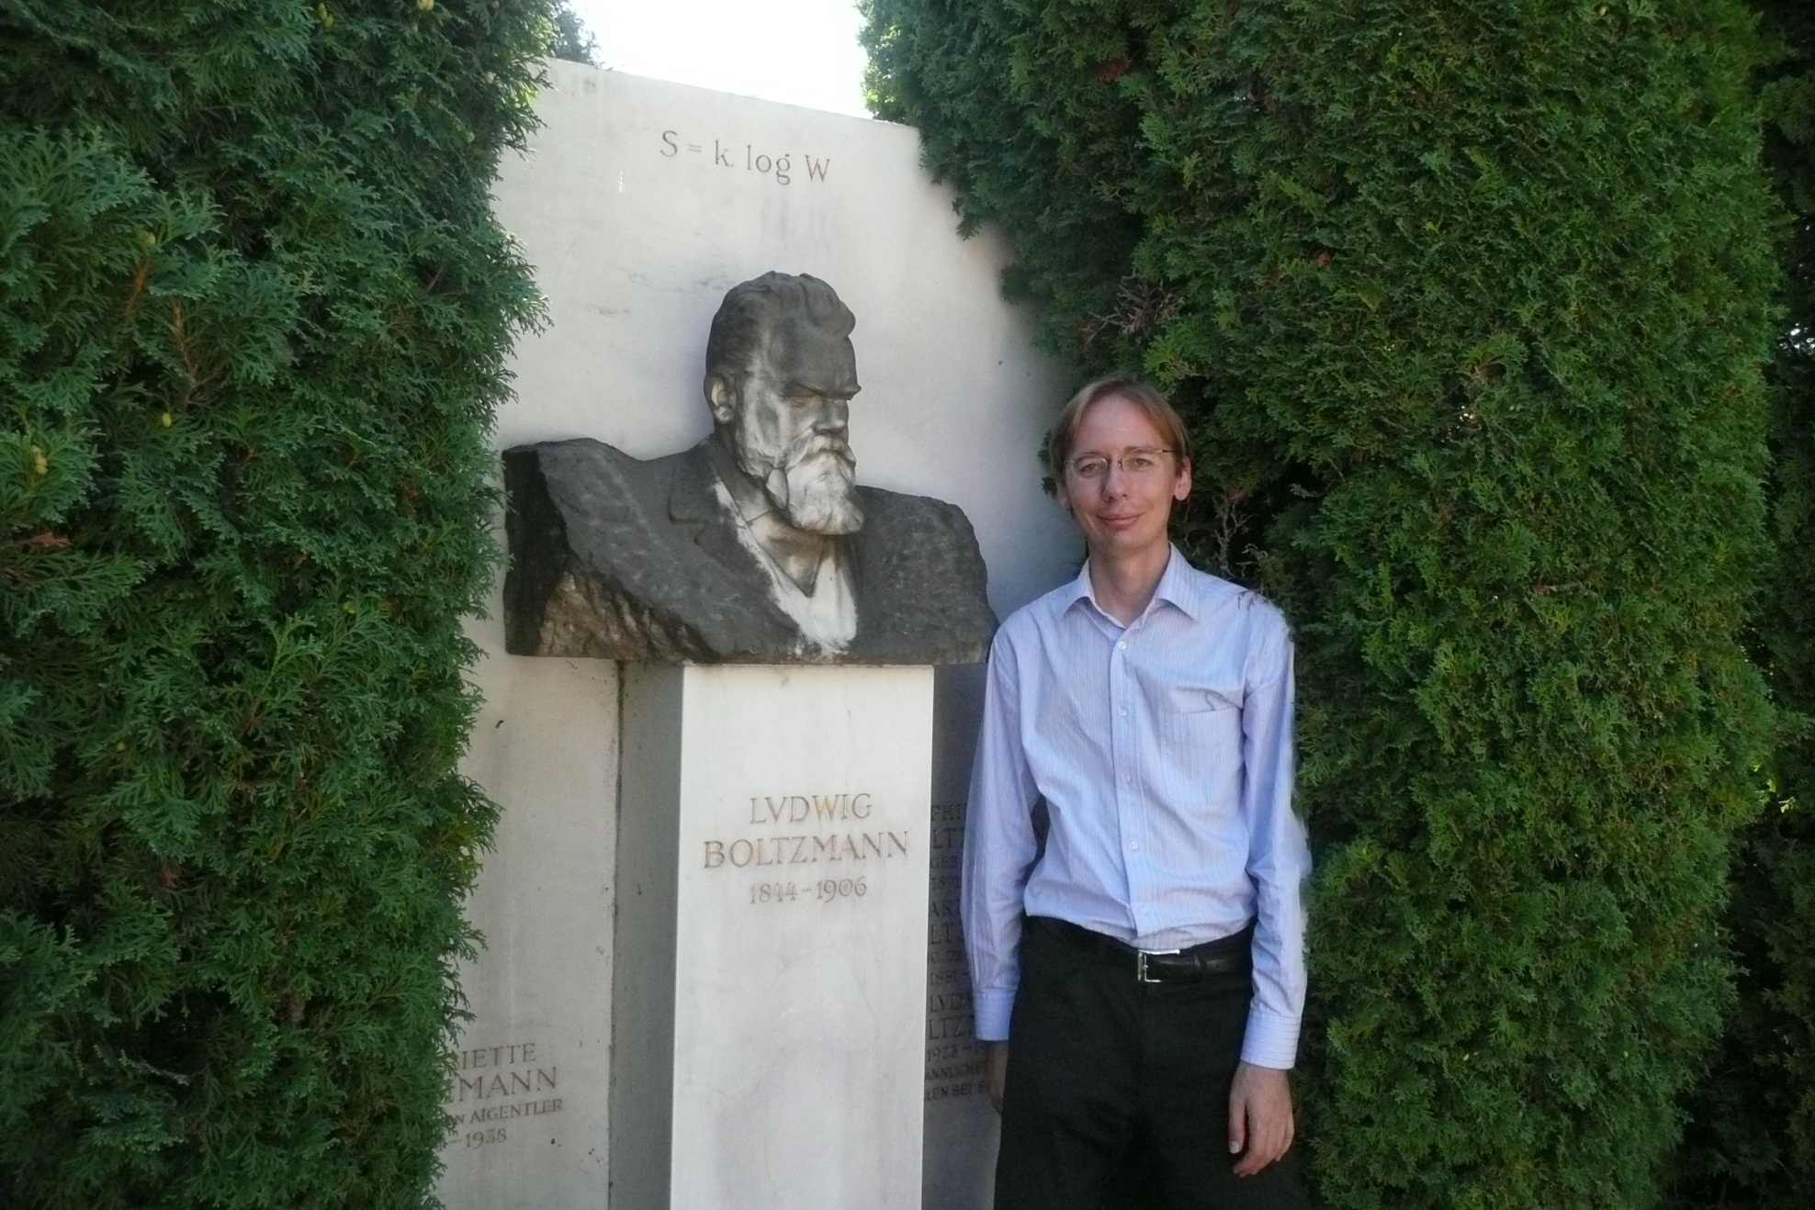
Ludwig Boltzmann 1844-1906
Cédric Villani interviendra
pendant le cours
du 14 mars 2012

